Slide 1

DataViz Portfolio Video
Xinting Yao

Slide 2

Interesting Works Done
Final Project
USA Airports On-Time Performance
Future Works

Slide 3

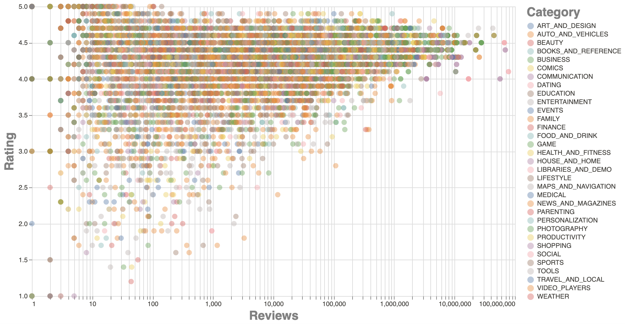
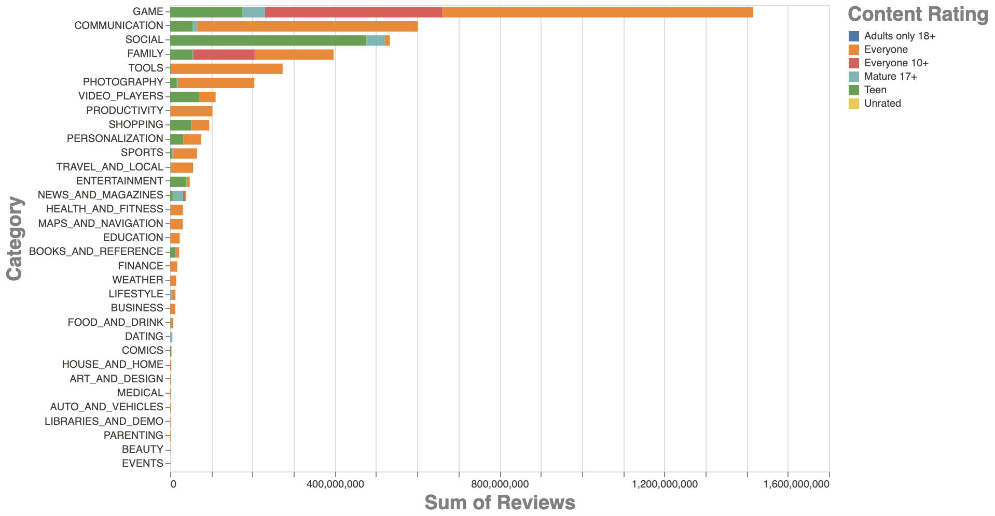
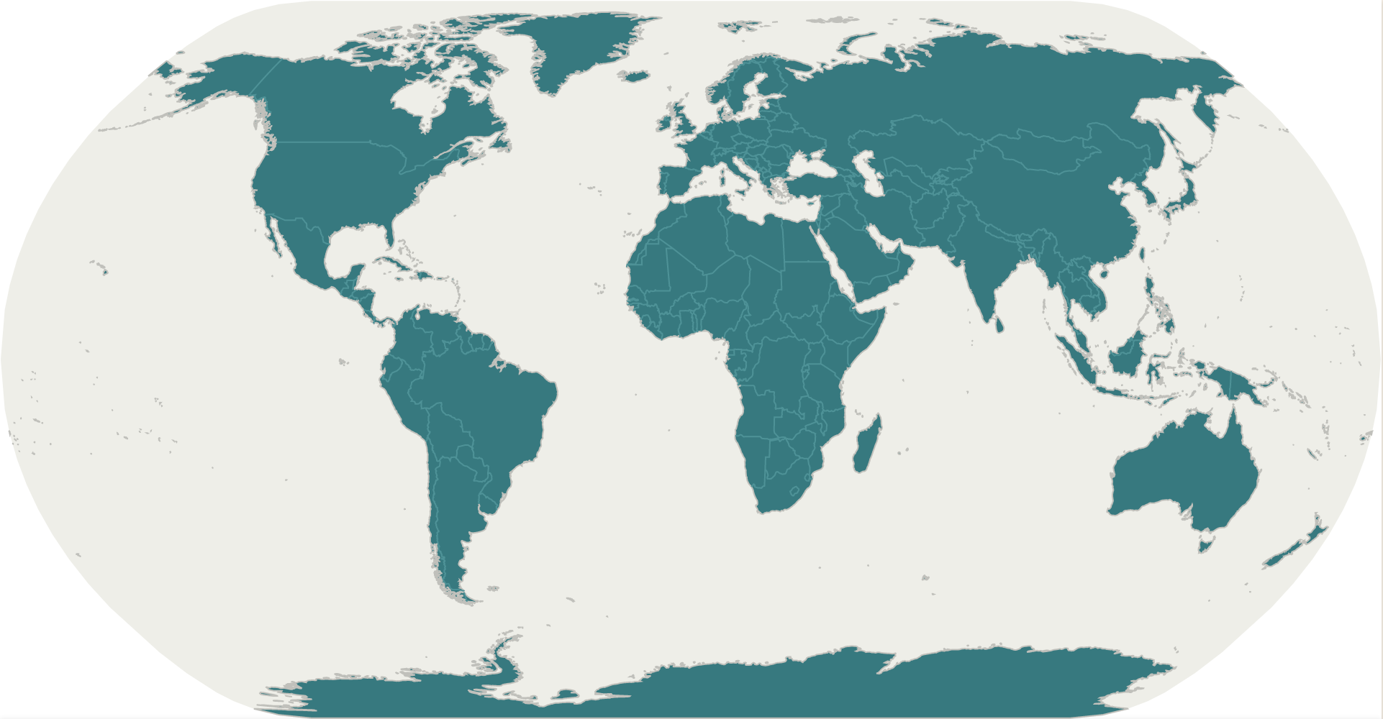
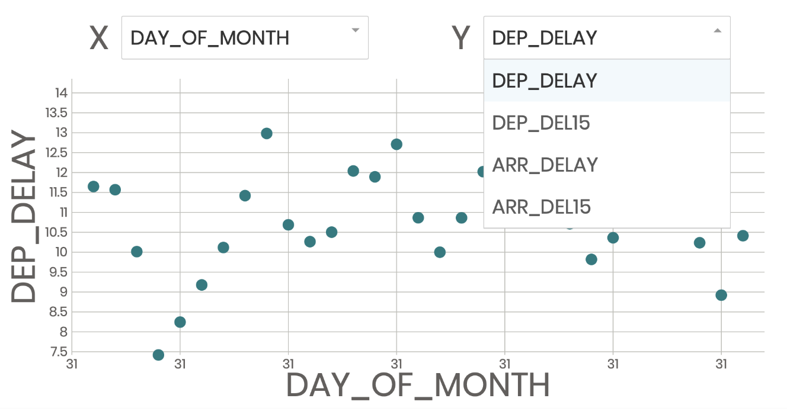
1
HTML
CSS
SVG
Circle
ellipse
path
rect
Circle, ellipse, path, rect, line, polygon, polyline
A Clown face
Vega-lite-api
D3
REACT

Slide 4
1
HTML
CSS
SVG
Circle
ellipse
path
rect
A Clown face
Circle, ellipse, path, rect, line, polygon, polyline

Slide 5
1
Vega-lite-api
Google Play Store Apps

Slide 6
1
Geospatial Data
Work with ‘TIME’
Menus
Tooltip
D3
REACT

Slide 7
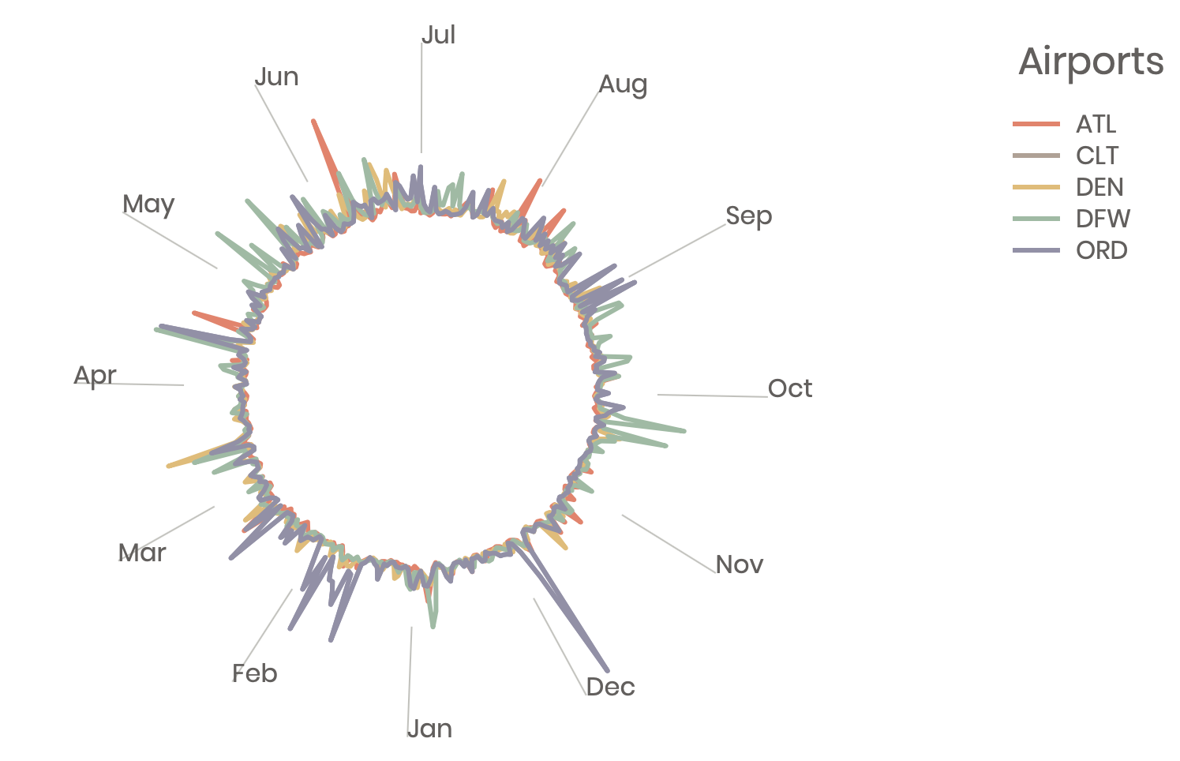
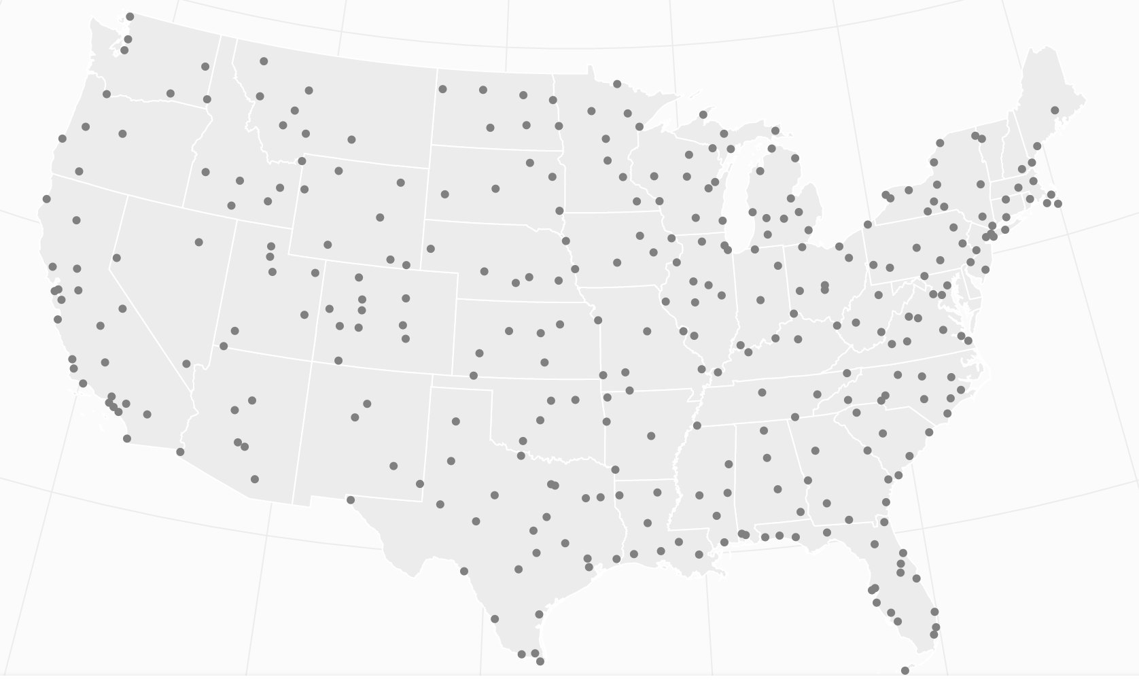
2
USA Airports On-time Performance
Map with airports’ locations
Radial Chart with Top-5 Busiest Airports
Vithub: https://beta.vizhub.com/Echo226/40f6502388de4c4d8e985fffbff1d23e
Github: https://github.com/Echo226/dataviz-usa-flights-performance

Slide 8
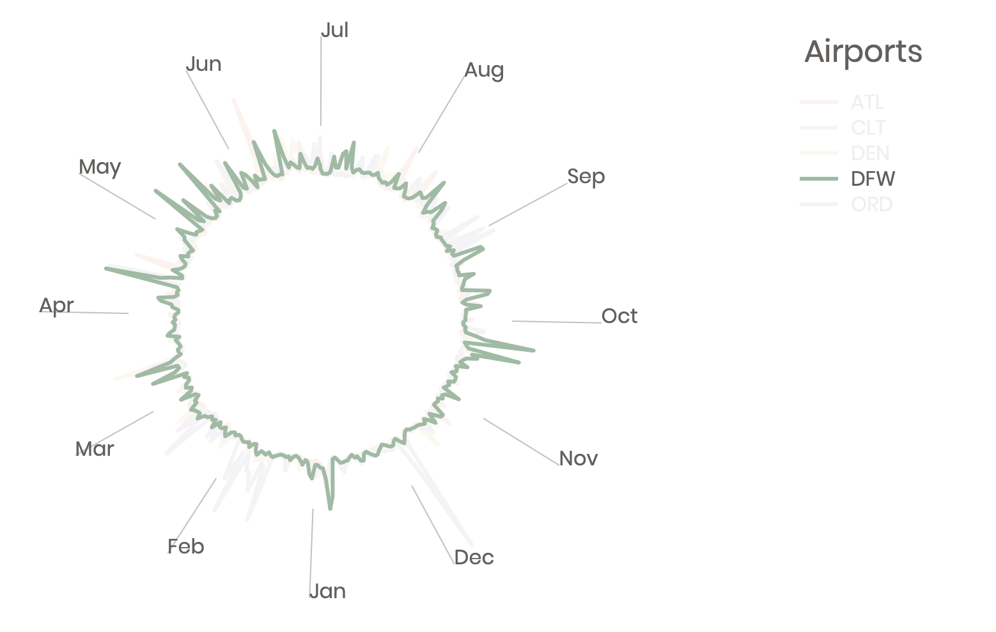
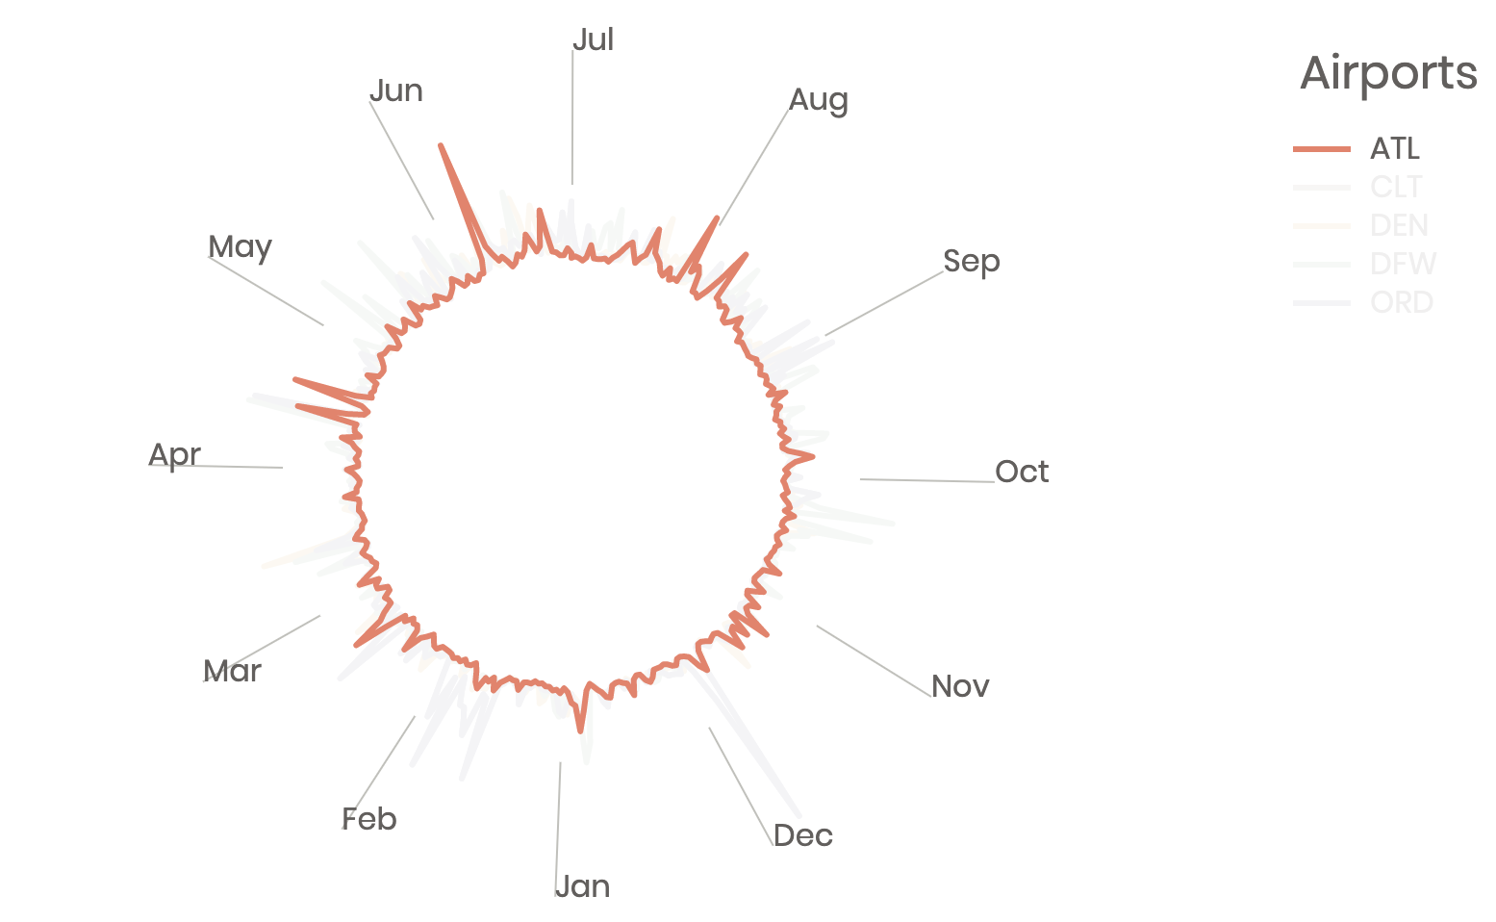
3
Future Works
15
10
5
0
Add Alaska and Hawaii to the map
Add radius axes to radial chart
Combine the Map with the Radial Chart

Slide 9
THANKS FOR WATCHING
Xinting Yao

